Slide 1
Welcome

Slide 2
Efficiency of Different Algorithms over Sparse Matrices
Muhammad Mohebujjaman
Graduate Student
Clemson University

Slide 3
Outline
Motivation
Objectives
Sparse Matrix
Representation of Sparse Matrix
Performance of Different Algorithms

Slide 4
Motivation
The large matrices that arise in real-world problems are often sparse.
Several algorithms for solving system of equations.
Different algorithms have different efficiencies.

Slide 5
Objectives
To count the number of iteration needs to converge
To compare the efficiency of different algorithms

Slide 6
Sparse Matrices
Sparse . . . . . .many elements are zero.
Dense . . . . . .few elements are zero.

Slide 7
Structured Sparse Matrices
Diagonal
Tri-diagonal
Lower triangular
May be mapped into a 1D array
Mapping function can be used to locate an element

Slide 8
Unstructured Sparse Matrices
Airline flight matrix.
  Airports are numbered 1 through n
  flight(i,j) = list of nonstop flights from airport i to airport j.
Web page matrix.
  Web pages are numbered 1 through n
  web(i,j) = number of links from page i to page j

Slide 9
Representation of Unstructured Sparse Matrices
MATLAB provides a sparse function of the form
matrix = sparse ( i, j, s, m, n, nz_max )
i = the row indices of the nonzero elements;
j = the column indices of the nonzero elements;
s = the values of the nonzero elements;
m = the number of rows in the matrix;
n = the number of columns in the matrix;
nz_max is the maximum number of nonzero elements in the matrix

Slide 10
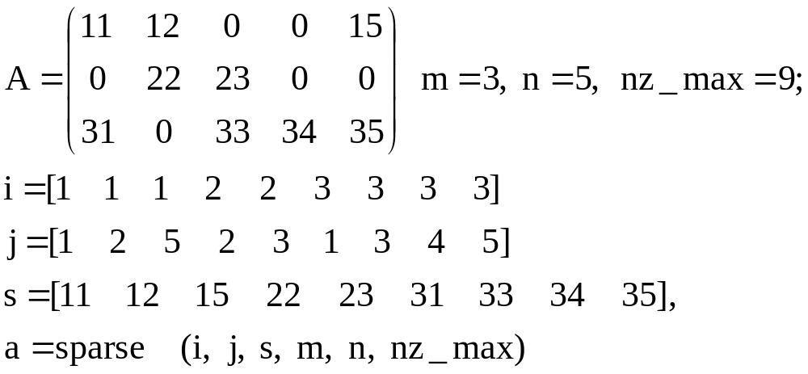
Representation of Unstructured Sparse Matrices

Slide 11
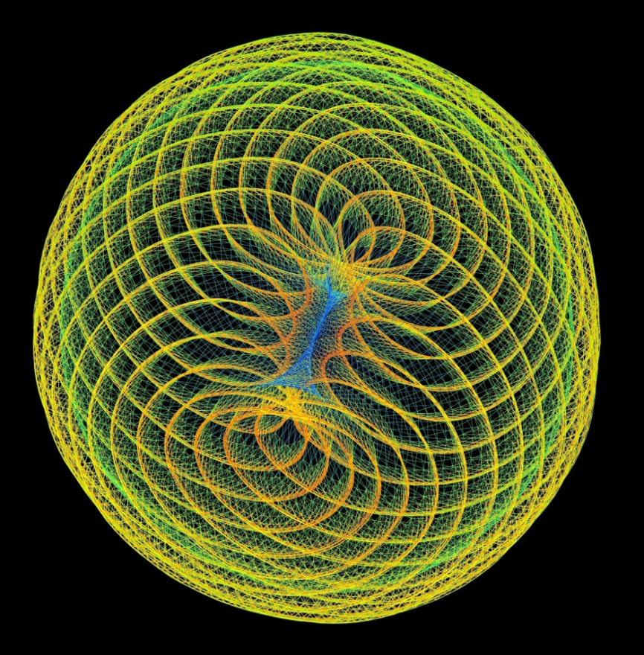
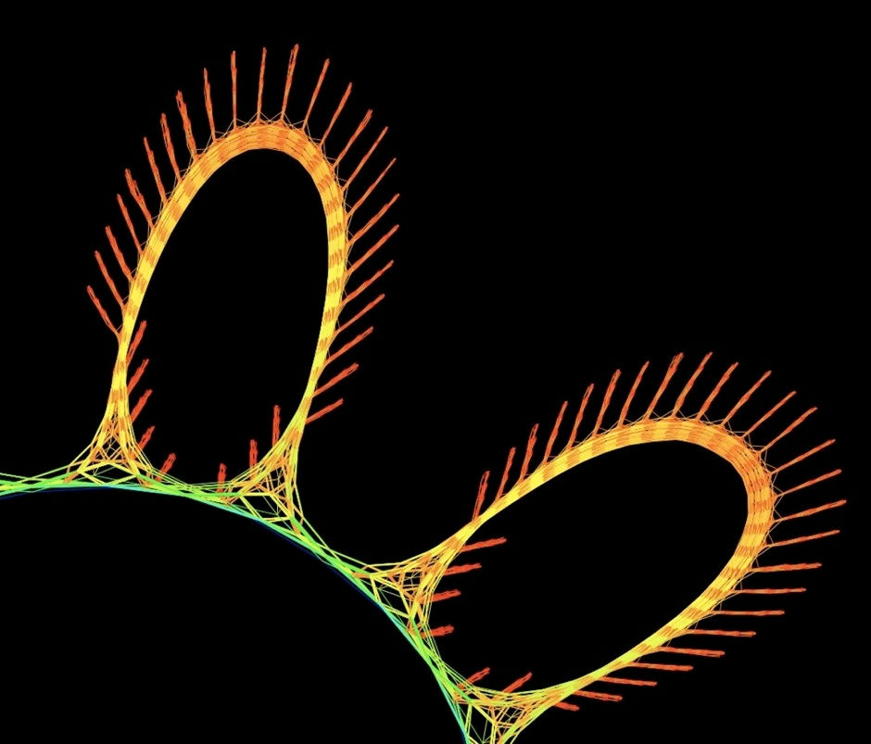
Examples of Sparse Matrices
A Barrier Hessian Matrix
A Matrix From Financial
Portfolio Optimization

Slide 12
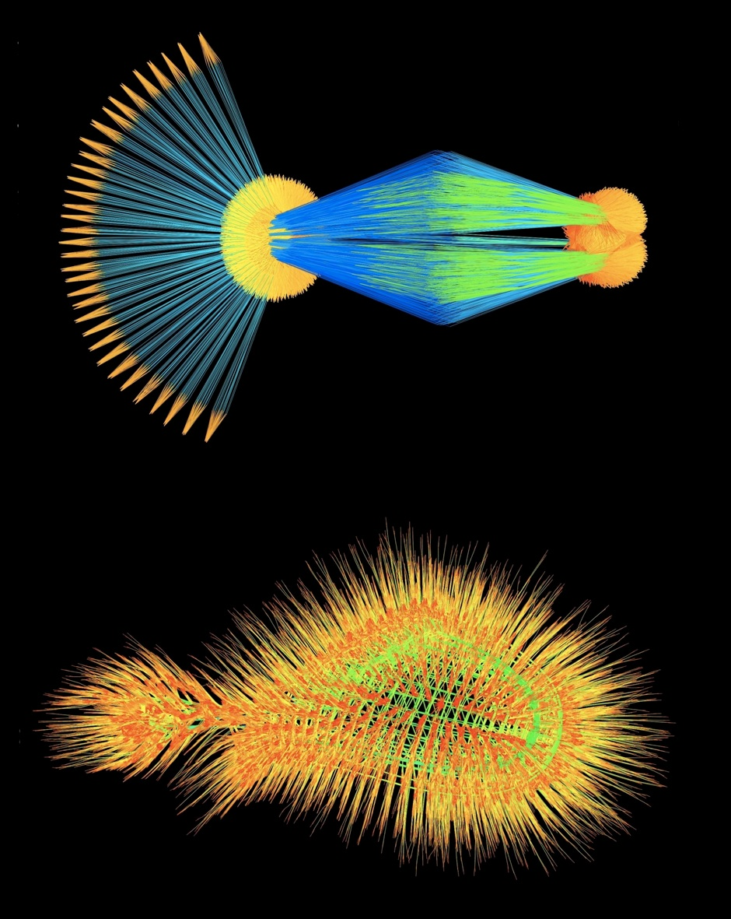
Examples of Sparse Matrices
http://www.cise.ufl.edu/~davis/matrices.html

Slide 13
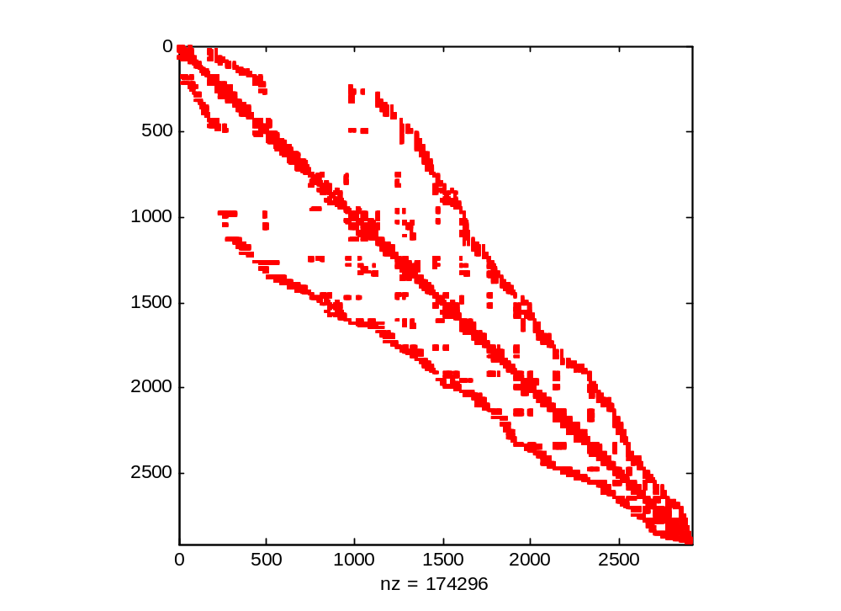
The Sparse Matrix

Slide 14
MATLAB Command
[X,FLAG, RELRES, ITER]=gmres ( A, B, RESTART, TOL, MAXIT, M )
[X,FLAG, RELRES, ITER]=Y( A, B, TOL, MAXIT, M )
Y for cgs, pcg, bicgstab.
FLAG = 0 , convergent to the desire TOL within MAXIT.
FLAG=1 , iterated MAXIT times, did not converge.
FLAG=2 , preconditioner M was ill-conditioned.
FLAG=3 , stagnated.
FLAG=4 , one of the scalar quantities calculated during the method Y became too small or too large to continue computing.

Slide 15
Efficiency of Algorithms
 | GMRES |  | CGS
 | Preconditioned | Without Preconditioned | Preconditioned | Without Preconditioned
FLAG | 0 | 0 | 3 | 4
ITER | 6510 | 37007 | 2070 | 2
RELRES | 9.943e-07 | 1.000e-6 | 3.0126e-04 | 0.231

Slide 16
Efficiency of Algorithms
 | PCG |  | BICGSTAB
 | Preconditioned | Without Preconditioned | Preconditioned | Without Preconditioned
FLAG | 0 | 0 | 0 | 0
ITER | 887 | 3470 | 1266.5 | 8061.5
RELRES | 9.8646e-07 | 9.7e-07 | 1.55e-07 | 8.48e-07

Slide 17
Conclusion
The Preconditioned Conjugate Gradient Method gives the better result.
If the matrix is not in symmetric positive definite, then this method may not works.
For unsymmetric matrix, GMRES provides the better result.

Slide 18
Thank You

